Slide 1

Predicting Climate Change Consequences with Machine Learning
Femina
12/09/2024

Slide 2
Objective and Hypotheses
Objective: To assess machine learning models for predicting weather and climate patterns across Europe, identifying critical predictors of climate change.
Hypotheses:
If machine learning models are trained on historical weather data, then they will be able to predict future extreme weather events with a reasonable degree of accuracy.
If specific weather stations in different regions of Europe are analyzed, then machine learning models will identify distinct trends in climate change that vary regionally.
If machine learning models are applied to weather data, then they can accurately classify days with pleasant and unpleasant weather conditions.

Slide 3
Data Source and Biases
Data from European weather stations, provided by the European Climate Assessment & Data Set project.
Biases:
Regional Bias: ML models trained primarily on data from specific regions may not represent global climate conditions leads to biased predictions.
Historical Data Bias: Climate data often reflects incomplete or biased historical records.
Over Predictions: Errors in predictions could lead to harmful outcomes like misallocation of resources, inadequate preparation for extreme weather, or neglect of vulnerable communities.

Slide 4
Optimization and Features
Data optimization involves various strategies to improve data management, ensuring better efficiency, reliability, and accessibility.
The goal is to maximize the utility of existing resources by refining how data is processed and used.
Gradient Descent:
Gradient Descent is a key method for finding the best-fit parameters for machine learning models.
It works by iteratively minimizing the error or cost function to get closer to the optimal solution.
Used to adjust model weights for higher accuracy and better predictions.

Slide 5
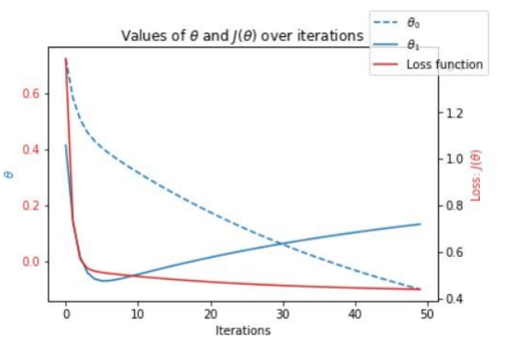
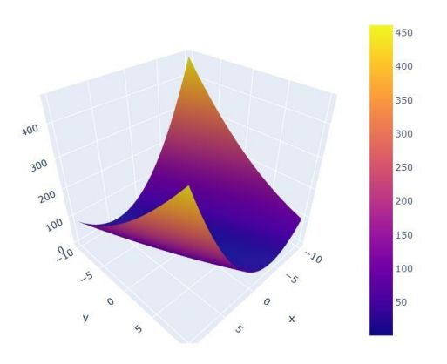
Optimization process for Debilt's 2021 weather data using gradient descent.
Loss Function
Key Insights:
The steep initial drop in the loss function suggests that the starting values for θ₀ and θ₁ were far from optimal.
This behavior indicates that the temperature data for Debilt in 2021 displayed significant variability or seasonality.
The model adjusted rapidly during the first few iterations to account for this variability, reflecting a need for further tuning of the learning rate or additional features.
Loss Profile

Slide 6
Supervised Learning and Algorithms:K-Nearest Neighbors (KNN) Model Analysis
What is KNN?
K-Nearest Neighbors (KNN) is a supervised learning algorithm used for classification and regression.
It classifies data points by comparing the input to the k nearest neighbors in the feature space and assigning the most common label among those neighbors.
KNN is simple yet effective for many problems, but its performance depends heavily on the choice of k (the number of neighbors).

Slide 7
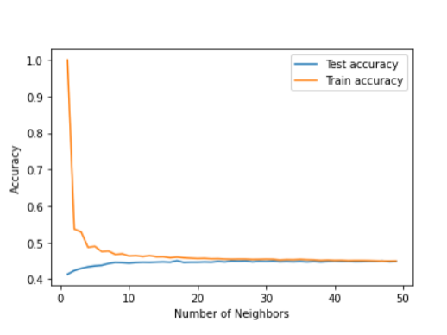
Observations from KNN Results:
Accuracy Plot
For small values of k (e.g., k=1), the model has high train accuracy (~100%) but low test accuracy.
This indicates overfitting—the model memorizes the training data but fails to generalize to unseen data.
When k increases to 4-5, both train and test accuracies stabilize, suggesting a balance between overfitting and underfitting.

Slide 8
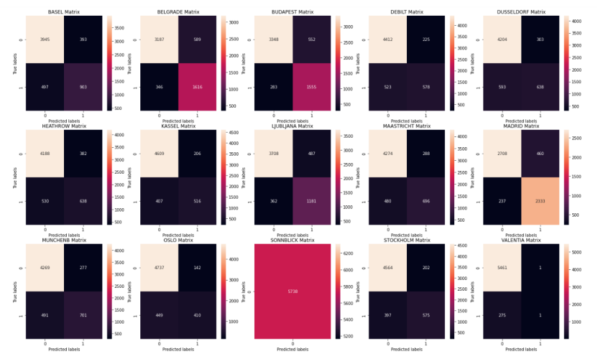
Performance by Weather Station(Using KNN Nodel):
High Accuracy (Kassel, Oslo, Stockholm, Valentia):
These stations show high prediction accuracy for both "pleasant" and "unpleasant" weather days.
The diagonal values in the confusion matrix (true positives and true negatives) indicate effective prediction for both classes.
Imbalance (Sonnblick):
The model only predicts "unpleasant" days, with no correct predictions for "pleasant" days.
This suggests data imbalance or unique weather conditions at this station affecting model performance.
Moderate Misclassifications (Heathrow, Munich, Debilt, Dusseldorf, Ljubljana):
These stations show confusion between predicting "pleasant" and "unpleasant" days.
Moderate misclassifications (off-diagonal values) indicate that the KNN model struggles with these locations.

Slide 9
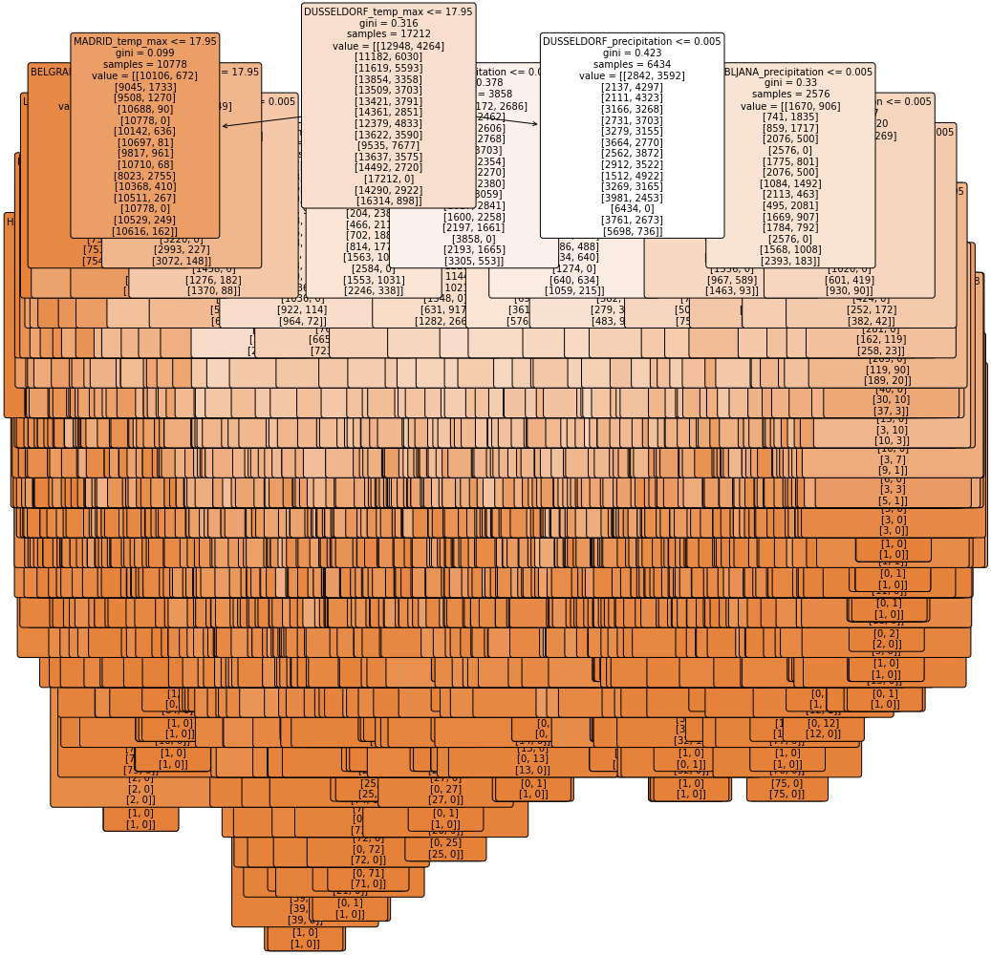
Decision Tree Model Analysis
Decision Tree for Climatewins data
What is a Decision Tree?
A Decision Tree is a supervised learning algorithm used for both classification and regression tasks.
It works by splitting the dataset into subsets based on feature values, forming a tree structure with decision nodes and leaf nodes.
The model recursively chooses the best feature to split the data, aiming to create the most homogeneous subsets.

Slide 10
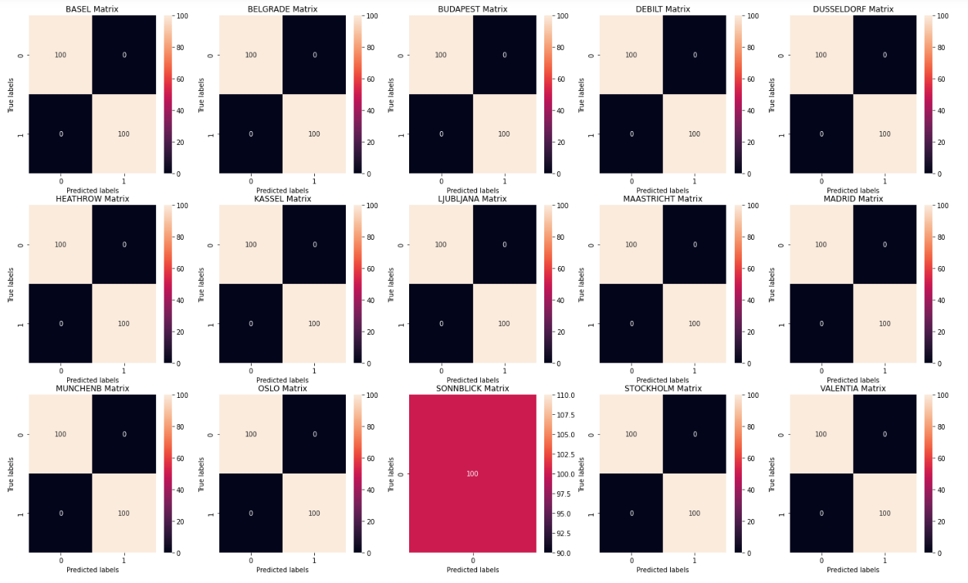
Training Data(Confusion Matrix in percentage) with 60% accuracy

Slide 11
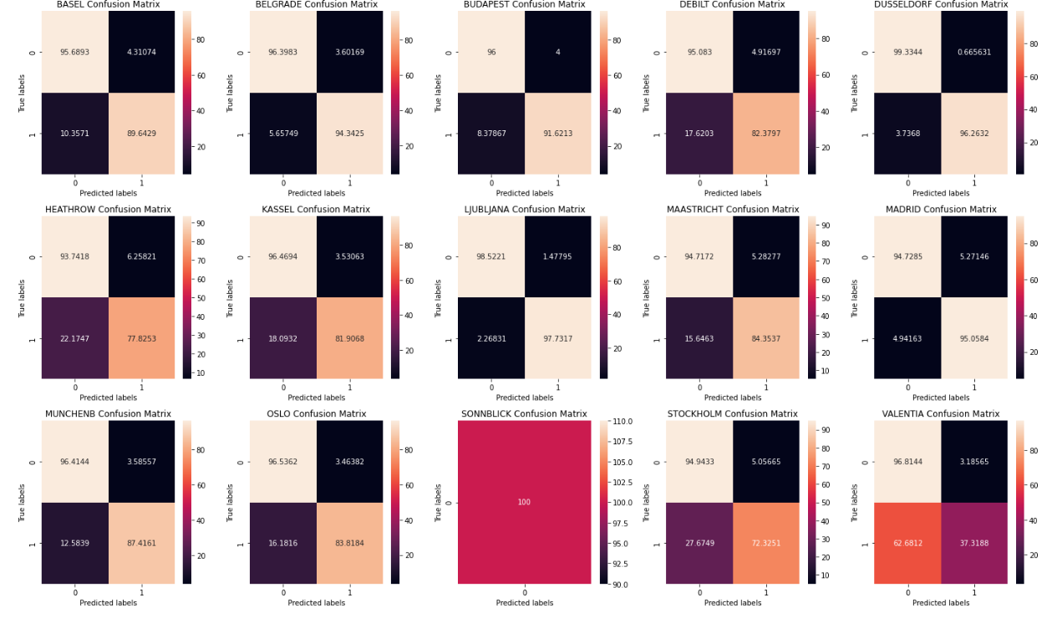
Testing Data(Confusion Matrix in percentage) with 63% accuracy

Slide 12
Artificial Neural Network (ANN) Model Analysis
What is an ANN?
Artificial Neural Networks (ANN) are computational models inspired by the human brain. They consist of interconnected layers of neurons that process information.
ANNs are effective at learning complex patterns in data by using multiple layers (input, hidden, and output) to transform inputs into predictions.

Slide 13
Model Architecture:
Hidden Layers: (35, 25, 15)
The model has 3 hidden layers with 35, 25, and 15 neurons, respectively.
Max Iterations: 2000
The model is allowed to train for a maximum of 2000 iterations.
Tolerance (tol): 0.00000001
The model stops when the improvement in the loss function becomes less than this value, ensuring convergence.
The ANN achieves 63% accuracy on training data and 60% accuracy on testing data, indicating moderate success in learning from the dataset.

Slide 14
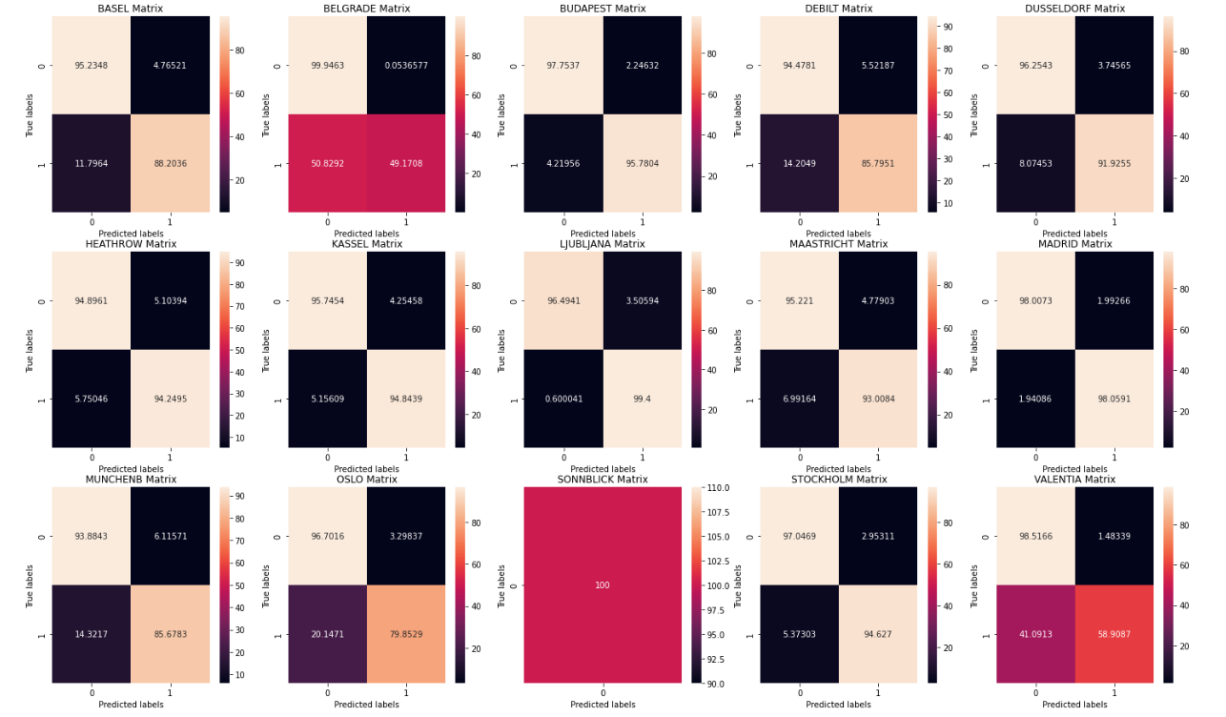
Training Data(Confusion Matrix in percentage) with 63% accuracy

Slide 15
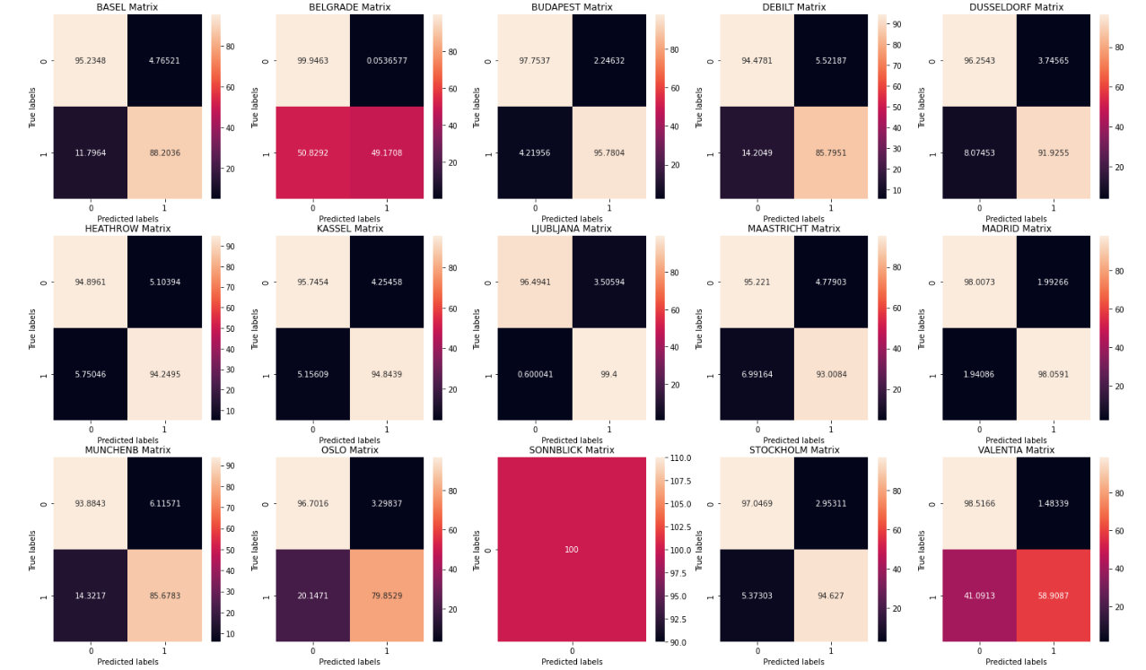
Testing Data(Confusion Matrix in percentage) with 60% accuracy

Slide 16
Summary and Future Steps
Hypotheses:
Machine learning models can predict pleasant and unpleasant weather days based on historical data.
Some weather stations, due to their unique conditions, may present imbalanced outcomes, affecting model performance.
Different machine learning models (KNN, ANN, Decision Tree) will perform variably across weather stations, with potential for overfitting or underfitting.

Slide 17
Summary and Future Steps
Methods Chosen:
KNN Model: Demonstrated the best performance for predicting weather patterns, with k values between 3-5 optimizing accuracy across most stations.
ANN Model: Showed balanced generalization but slightly lower accuracy (~60%) compared to KNN.
Decision Tree: The decision tree shows strong performance in classifying unpleasant climates across most locations but faces challenges when it comes to pleasant weather, especially in cities with higher variability or imbalance in their climate data.

Slide 18
Summary and Future Steps
Next Steps:
Further optimize the KNN model, especially focusing on improving accuracy at stations like Sonnblick and Heathrow.
Enhance data preprocessing, including addressing data imbalances for stations where prediction struggles.
Tune hyperparameters in the ANN model to improve overall accuracy and capture more complex weather patterns.
Experiment with alternative models (e.g., Random Forest, SVM) to explore different approaches for predicting difficult stations.

Slide 19

THANK YOU
Feel free to ask any questions or request further details.
Femina
fjasmin76@gmail.com

